Slide 1
Programming Logic & Techniques

Slide 2
Introduction to Compilation

Slide 3
Interpreters & Compilers
Interpreter
A program that reads a source program and produces the results of executing that program
Compiler
A program that translates a program from one language (the source) to another (the target)

Slide 4
Common Issues
Compilers and interpreters both must read the input – a stream of characters – and “understand” it; analysis
w h i l e ( k < l e n g t h ) { <nl> <tab> i f ( a [ k ] > 0
) <nl> <tab> <tab>{ n P o s + + ; } <nl> <tab> }

Slide 5
Interpreter
Interpreter
Execution engine
Program execution interleaved with analysis
running = true;
while (running) {
analyze next statement;
execute that statement;
}
May involve repeated analysis of some statements (loops, functions)

Slide 6
Compiler
Read and analyze entire program
Translate to semantically equivalent program in another language
Presumably easier to execute or more efficient
Should “improve” the program in some fashion
Offline process
Tradeoff: compile time overhead (preprocessing step) vs execution performance

Slide 7
Typical Implementations
Compilers
FORTRAN, C, C++, Java, COBOL, etc. etc.
Strong need for optimization, etc.
Interpreters
PERL, Python, awk, sed, sh, csh, postscript printer, Java VM
Effective if interpreter overhead is low relative to execution cost of language statements

Slide 8
Hybrid approaches
Well-known example: Java
Compile Java source to byte codes – Java Virtual Machine language (.class files)
Execution
Interpret byte codes directly, or
Compile some or all byte codes to native code
(particularly for execution hot spots)
Just-In-Time compiler (JIT)
Variation: VS.NET
Compilers generate MSIL
All IL compiled to native code before execution

Slide 9
Compilers: The Big picture
Source code
Compiler
Assembly code
Assembler
Object code
(machine code)
Linker
Fully-resolved object
code (machine code)
Loader
Executable image

Slide 10
UML

Slide 11
Objectives
Define UML
Define use case diagram
Define UML notations to define use case diagram
How to capture requirements using use case diagram?

Slide 12
UML
UML: Unified Modeling Language
An industry-standard graphical language for specifying, visualizing, constructing, and documenting the artifacts of software systems, as well as for business modeling.
The UML uses mostly graphical notations to express the OO analysis and design of software projects.
Simplifies the complex process of software design
Visualizing - a picture is worth a thousand words; a graphical notation articulates and unambiguously communicates the overall view of the system (problem-domain).

Slide 13
Types of UML Diagrams
Use Case Diagram:
Capture requirements.
Clarify exactly what the system is supposed to do
Displays the relationship among actors and use cases.
Different from traditional flow chart.
Class Diagram
Static relationships between classes.
Describe the types of objects in the system and various kinds of static relationship that exist among them.
Sequence Diagram
Displays the time sequence of the objects participating in the interaction.

Slide 14
Types of UML Diagrams
Collaboration Diagram
Displays an interaction organized around the objects and their links to one another.
State Diagram
Displays the sequences of states that an object of an interaction goes through during its life in response to received stimuli, together with its responses and actions.
Component Diagram
Illustrate the organizations and dependencies of the physical components in a system. A higher level than class diagrams.

Slide 15
UML Use Case Diagrams
UML gives us a graphical language to organize all our use case scenarios into one overview.
Use Case Diagrams
These display:
actors
use cases
associations, i.e. which actors are involved in which scenario

Slide 16
Use Case Modeling
Use Case Modeling involves three steps that may be repeated until we are satisfied.
Step 1. Identify, name and define each actor in terms of:
Goals, i.e. what the actor wants to do,
Needs, i.e. what services from the system the actor requires to meet each goal.
Step 2. For each system service (identified in Step 1), informally describe the
preconditions and
results of the service, and its,
interaction with the actors in:
a typical case (sunny day scenario).
exceptional and error cases (rainy day scenario)
Step 3: formalize the interaction of the system and the relevant actors using a sequence diagram

Slide 17
Use Case Modeling
1. Actors
3. Sequence
Diagrams
2. Use
cases

Slide 18
Use case Diagram
Actors: A role that a user plays with respect to the system, including human users and other systems. e.g. Inanimate physical objects (e.g. robot); an external system that needs some information from the current system.
Use case: A set of scenarios that describing an interaction between a user and a system.

Slide 19
Use case Diagram
System boundary: a rectangle diagram representing the boundary between the actors and the system.
Association: communication between an actor and a use case; represented by a solid line.
Generalization: relationship between one general use case and one specific use case. Represented by a line with a triangular arrow head toward the parent use case, the more general modeling element.
employee
waitress

Slide 20
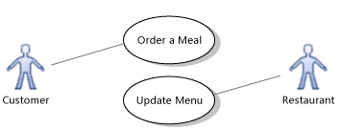
Use Case Modeling example
An online meal selling system must allow customers to Order a meal, and must allow the providing restaurants to update the menu. You can summarize this in a use case diagram

Slide 21
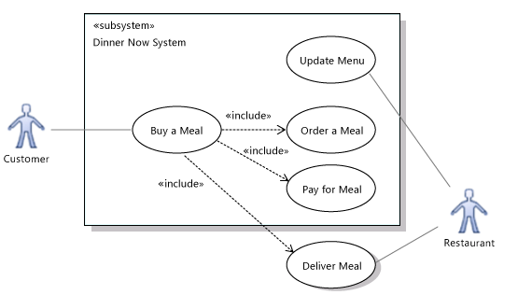
Use Case Modeling example
You can also show how a use case is composed of smaller cases. For example, ordering a meal is part of buying a meal, which also includes payment and delivery:
the system in the illustration does not take part in the Deliver Meal use case

Slide 22
Use Case Modeling example
Problem statement
The university will require a new Course Registration system.
At the beginning of each semester, professors at the university will register the courses that they are going to teach with the system.
The system then will allow students to request a course catalogue containing a list of course offerings for the coming semester. Information about each course such as professor, department and prerequisites are included.
The student then can select four-course offering. Once the registration process is completed for a student, the registration system sends information to the billing system so the student can be billed for the semester.
For each semester, there is a period of time that students can change their schedule through adding or dropping courses.
Professors must be able to access the system to indicate which courses they will be teaching and to see which students signed up for their course offerings.

Slide 23
Use Case Modeling example detailed
Find the Actors
Find nouns
Not every noun will be an actor
But every actor will be a noun

Slide 24
Use Case Modeling example detailed
Finding Actors
A person who is registered to take courses at the University
A person who is teaching classes at the University
Student
Professor
The external system responsible for student billing
The person who is responsible for the maintenance of the course registration system
Billing
System
Registrar

Slide 25
Use Case Modeling example detailed
Finding use cases: Focus on Actor
The system exists only for its users
Use cases should be based on the user’s needs
For each actor you have identified, what are the tasks the system would be involved in?
Does the actor need to be informed about certain occurrences in the system
The name indicates what is achieved by its interactions with the actor(s).
The name may be several words in length.
No two use cases should have the same name.
Register for
Courses
Login
Maintain Student
Information

Slide 26
Use Case Modeling example detailed
View Report Card
Student
Register for Courses
Maintain Professor Information
Login
Maintain Student Information
Select Courses to Teach
Registrar
Professor
Submit Grades
Close Registration
Billing System

Slide 28
Objectives
Define following process model: waterfall and Agile
List advantages and disadvantages of different process

Slide 29
Process Models
Waterfall Model
Agile Model

Slide 30
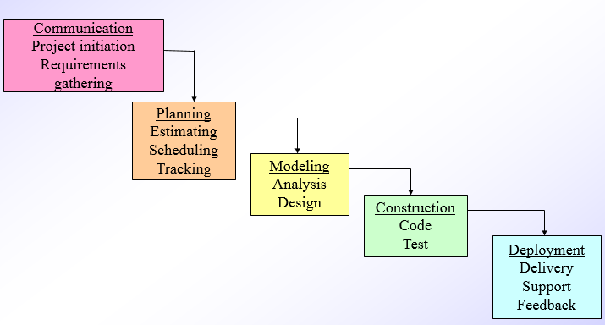
Waterfall Model
Oldest software lifecycle model and best understood by upper management
Used when requirements are well understood and risk is low
Work flow is in a linear (i.e., sequential) fashion
Used often with well-defined adaptations or enhancements to current software

Slide 31
Waterfall Model: Advantages and Disadvantages
Advantages | Disadvantages
Simple and easy to understand and use | Once an application is in the testing stage, it is very difficult to go back and change something that was not well-thought out in the concept stage
Easy to manage due to the rigidity of the model – each phase has specific deliverables and a review process | Difficult for customers to state all requirements explicitly and up front
Phases are processed and completed one at a time | Requires customer patience because a working version of the program doesn't occur until the final phase
Works well for smaller projects where requirements are very well understood | Not suitable for the projects where requirements are at a moderate to high risk of changing

Slide 32
The Manifesto of Agile Software Development
“We are uncovering better ways of developing software by doing it and helping others do it. Through this work we have come to value
Individuals and interactions over processes and tools
Working software over comprehensive documentation
Customer collaboration over contract negotiation
Responding to change over following a plan”
-- Kent Beck et al

Slide 33
What is Agility?
Effective (rapid and adaptive) response to change
Effective communication among all stakeholders
Drawing the customer onto the team
Organizing a team so that it is in control of the work performed
Yielding …
Rapid, incremental delivery of software

Slide 34
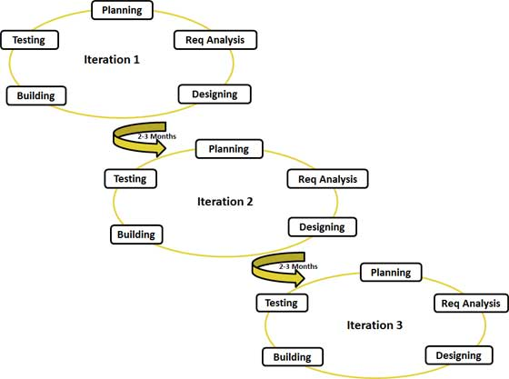
An Agile Process
Is driven by customer descriptions of what is required (scenarios)
Recognizes that plans are short-lived
Develops software iteratively with a heavy emphasis on construction activities
Delivers multiple ‘software increments’
Adapts as changes occur

Slide 35
Agile: Advantages and Disadvantages
Advantages | Disadvantages
Promotes teamwork and cross training | An overall plan, an agile leader and agile PM practice is a must without which it will not work
Functionality can be developed rapidly and demonstrated | Depends heavily on customer interaction, so if customer is not clear, team can be driven in the wrong direction
Resource requirements are minimum | There is very high individual dependency, since there is minimum documentation generated
Suitable for fixed or changing requirements
Delivers early partial working solutions
Good model for environments that change steadily.

Slide 36
Agile Methodologies
Some of the well-known agile software development methods and/or process frameworks include
SCRUM

Slide 37
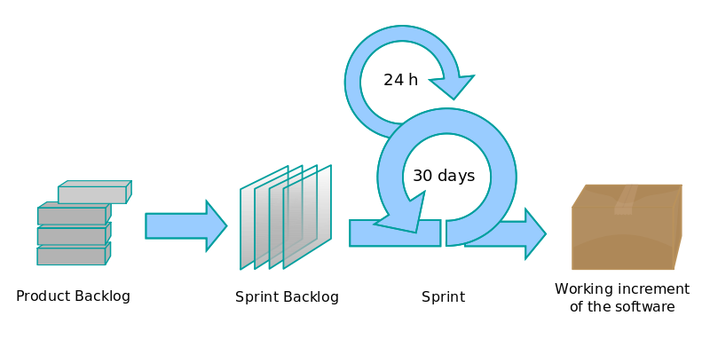
SCRUM
Scrum is an iterative and incremental agile software development framework for managing software projects and product or application development.
It defines "a flexible, holistic product development strategy where a development team works as a unit to reach a common goal".
A key principle of Scrum is its recognition that during a project the customers can change their minds about what they want and need (often called requirements churn), and that unpredicted challenges cannot be easily addressed in a traditional predictive or planned manner.
As such, Scrum adopts an empirical approach—accepting that the problem cannot be fully understood or defined, focusing instead on maximizing the team's ability to deliver quickly and respond to emerging requirements

Slide 38
SCRUM and SPRINT
A sprint is a get-together of people involved in a project to give a focused development on the project. Sprints are typically two to seven days long. Sprints have become popular events among some open source projects.
A sprint (or iteration) is the basic unit of development in Scrum.
The sprint is a "timeboxed" effort; that is, it is restricted to a specific duration.
Scrum projects do not define progress in terms of a straight line but instead as a series of sprints which are timeboxed iterations for a given period of time, typically a month or a few weeks.
The duration is fixed in advance for each sprint and is normally between one week and one month, although two weeks is typical.

Slide 39
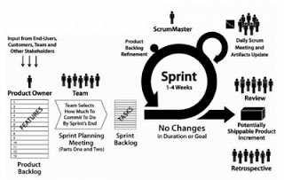
SCRUM and SPRINT
To carry out this process, the entire team will need to assign two positions: a ScrumMaster and a product owner.
The ScrumMaster's purpose is to act as a coach, essentially helping each member of the team figure out how they can best contribute to the framework.
The product owner represents the target consumer and basically guides the team into creating a product which fits well with the demands of the business as well as its target consumers.

